Slide 1
White Blood Cell Classification
Team 3: Michael Chen and Allen Zhu

Slide 2
Background on Research and Dataset
In order to detect blood-based diseases, blood samples are needed from the patient.
The automation of blood subtype characterization can smoothen hospital workflow, and rapidly provide critical information to healthcare workers.
Many blood-based diseases can be determined through the monitoring of white blood cells.
MIT-based Kaggle challenge to provide ~12000 white blood cell images.

Slide 3
Data
 | train | test | test_simple** | Total
Eosinophil | 2497 | 623 | 13 | 3133
Lymphocyte | 2483 | 620 | 6 | 3109
Monocyte | 2478 | 620 | 4 | 3102
Neutrophil | 2499 | 624 | 48 | 3171
Total | 9957 | 2487 | 71 | 12515
** indicates images with no augmentation

Slide 4
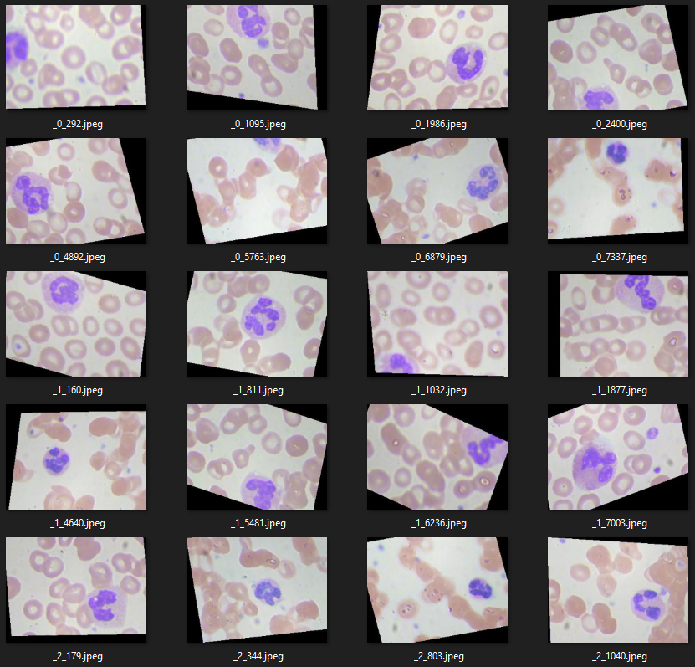
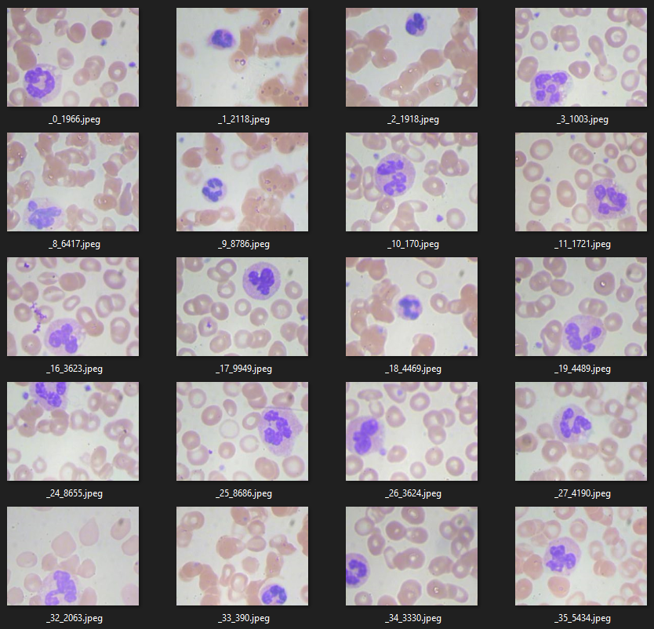
Data Augmentation
Augmented (train and test sets)
Not Augmented (test_simple set)

Slide 5
Architectures
ResNet
Autoencoder Classifier

Slide 6
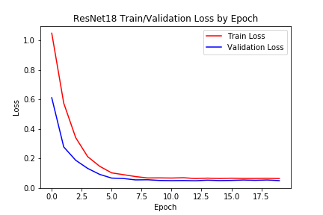
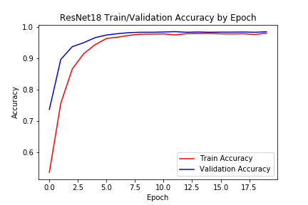
ResNet18
Simple changes to ensure working supporter functions
Ran 1 iteration
T: 98.0%
V: 98.5%
 | Accuracy
test | 85.7%
test_simple | 25.4%

Slide 7
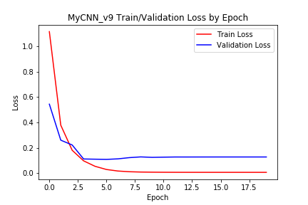
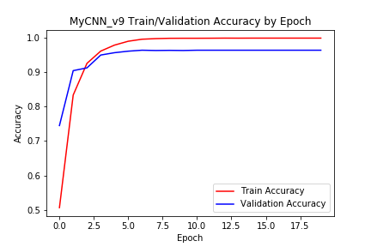
Custom CNN w/ ResBlocks
Simple hyperparameter tuning
Architectural changes
Ran 30 iterations
T: 100.0%
V: 96.4%
v4 | Accuracy
test | 85.4%
test_simple | 74.6%
v9 | Accuracy
test | 86.5%
test_simple | 84.5%
v11 | Accuracy
test | 88.2%
test_simple | 78.9%
Notes:
Simple hyperparameter tuning (batch size, epochs, learning rate, input/output sizes, etc.)
Architectural changes (deeper network, shallower network, batch normalization, dropout, “ACNet”)

Slide 8
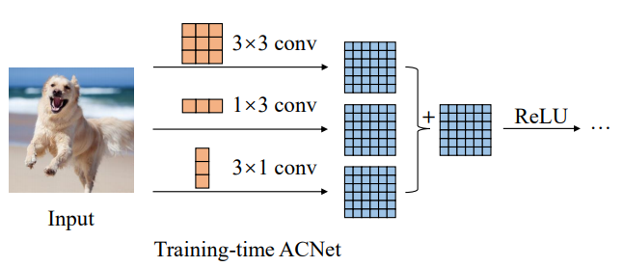
Asymmetrical Convolution Blocks (ACBs)
 | Accuracy
test | 82.5%
test_simple | 64.8%

Slide 9
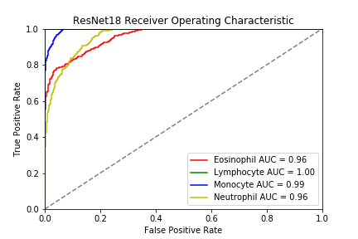
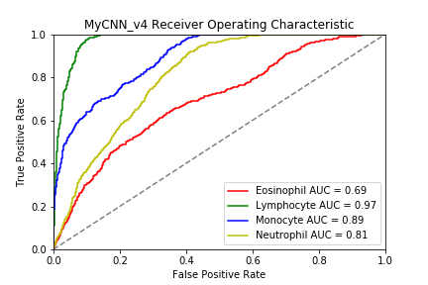
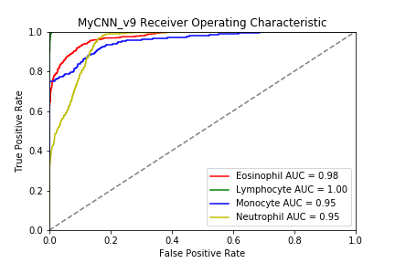
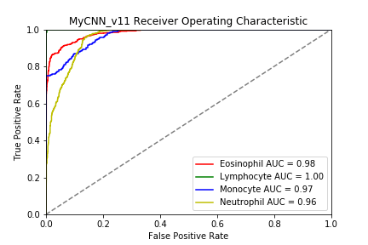
Additional Finding

Slide 10
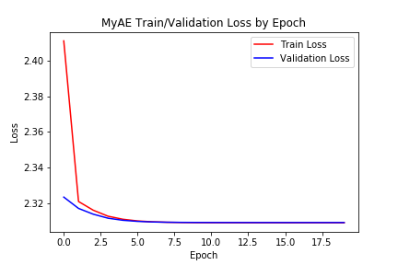
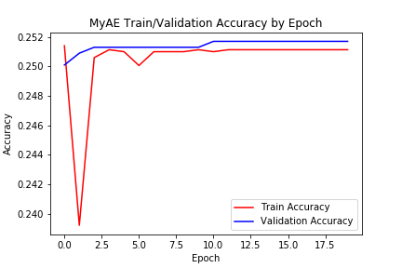
Autoencoder Classifier
Added classification layer
Simple hyperparameter tuning
Tried with and without hidden layer in encoder/decoder
Ran 4 iterations
 | Accuracy
test | 25.1%
test_simple | 18.3%

Slide 11
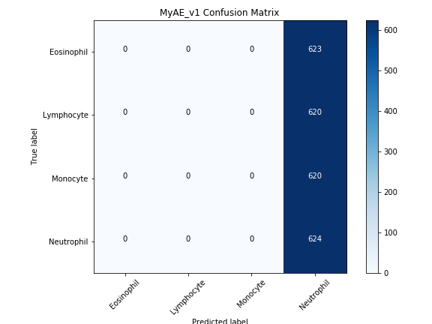
Autoencoder Classifier
Added classification layer
Simple hyperparameter tuning
Tried with and without hidden layer in encoder/decoder
Ran 4 iterations
 | Accuracy
test | 25.1%
test_simple | 18.3%

Slide 12
Lessons from Inception
Factorization
Bottleneck
Wide not deep.

Slide 13
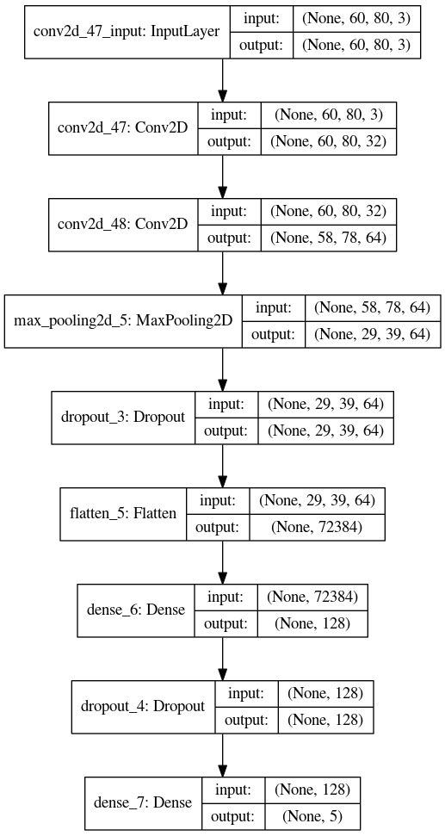
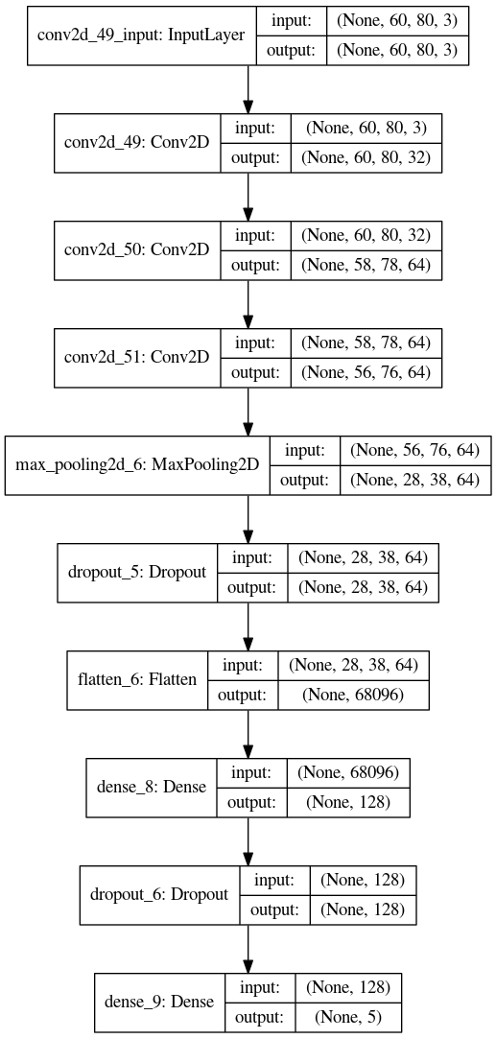
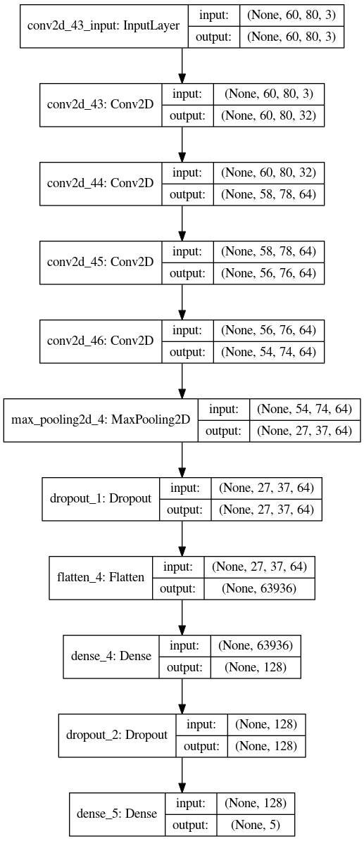
Simple Models Featuring Bottlenecks and Factorization
1 (3x3) conv. layers
2 (3x3) conv. layers
3 (3x3) conv. layers

Slide 14
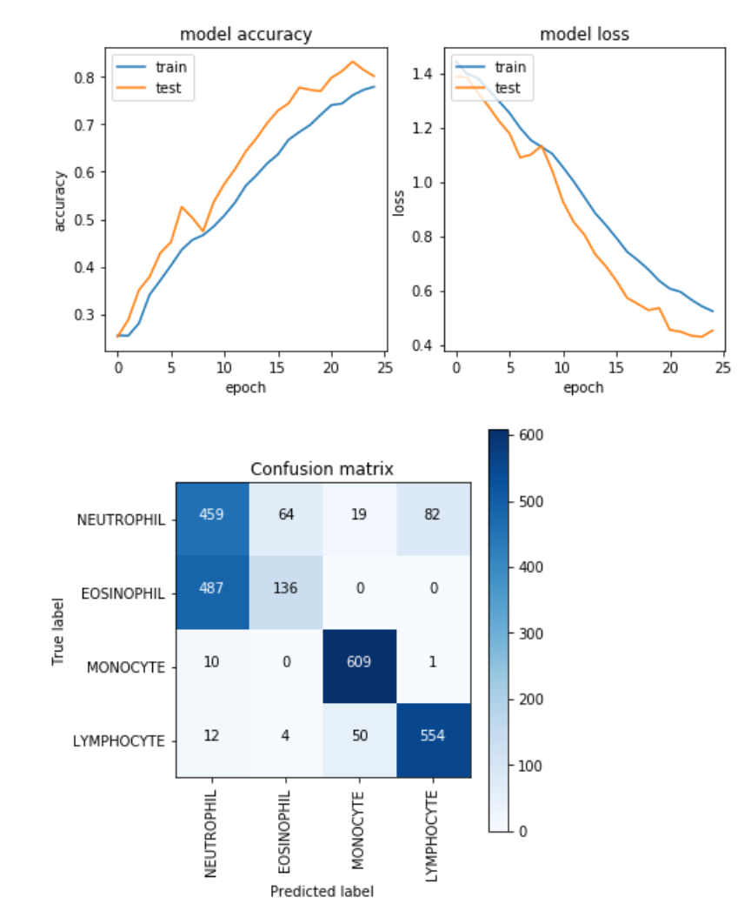
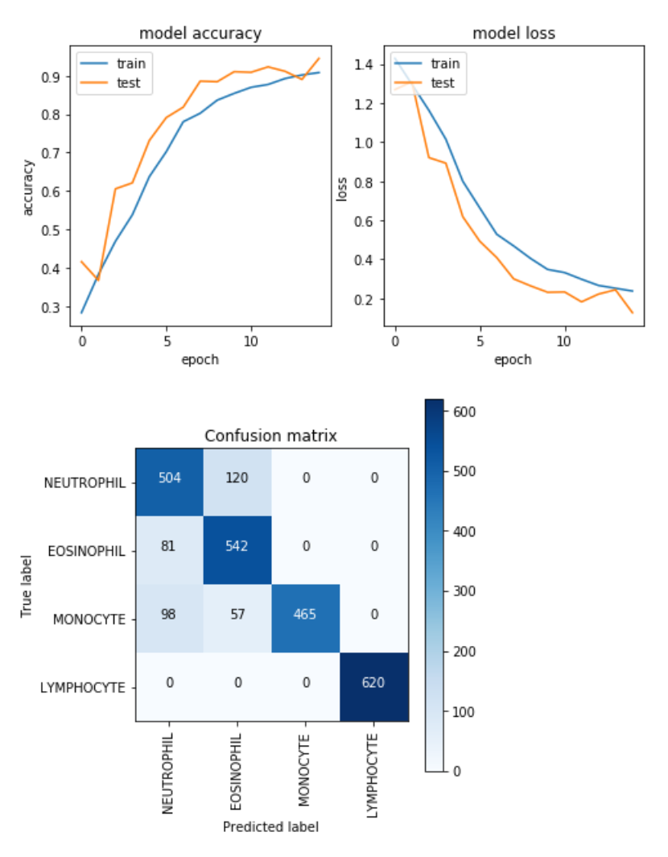
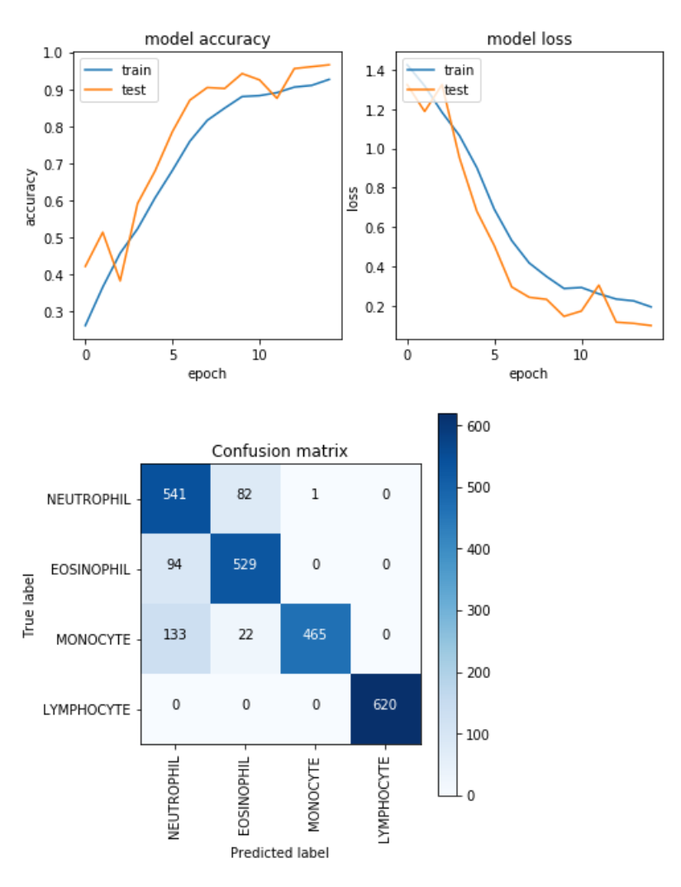
Simple Model Performances
1 (3x3) Convolutions:
Evaluation Accuracy: 73%
2 (3x3) Convolutions:
Evaluation Accuracy: 87%
3 (3x3) Convolutions:
Evaluation Accuracy: 88%

Slide 15
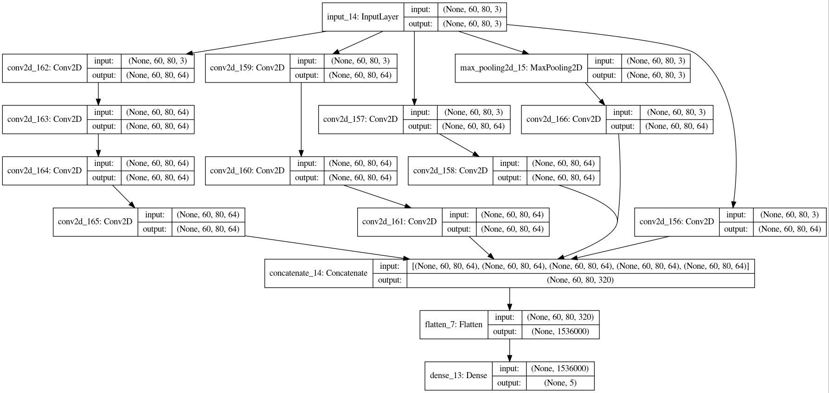
Attempting Wider Models: All in Parallel

Slide 16
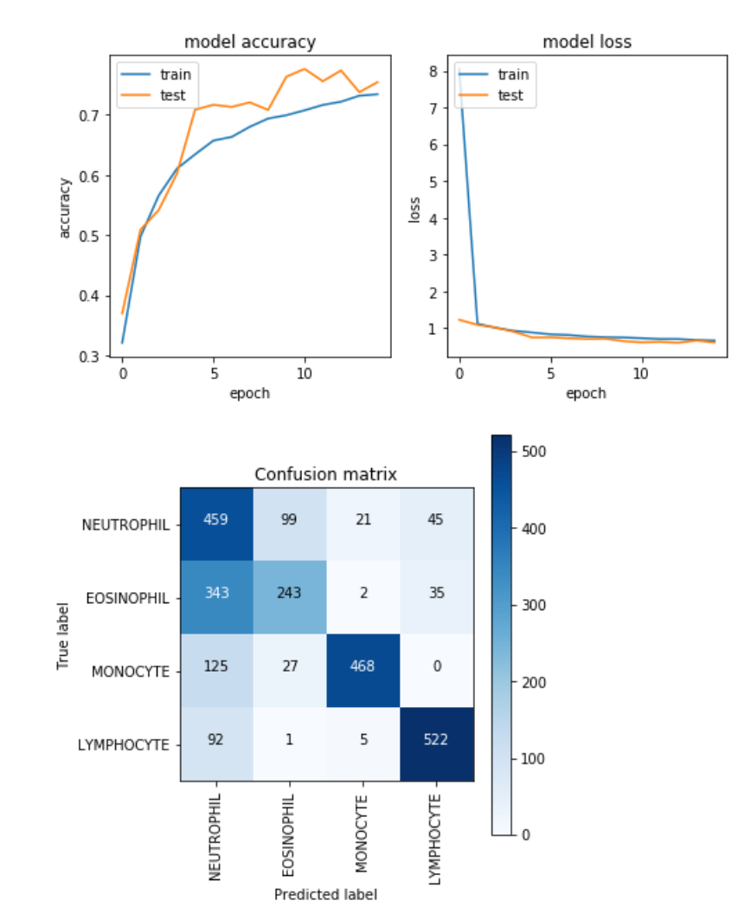
Results...Not Impressive
Performance the same as having a single 3x3 convolution
73% Accuracy
More epochs possibly needed.

Slide 17
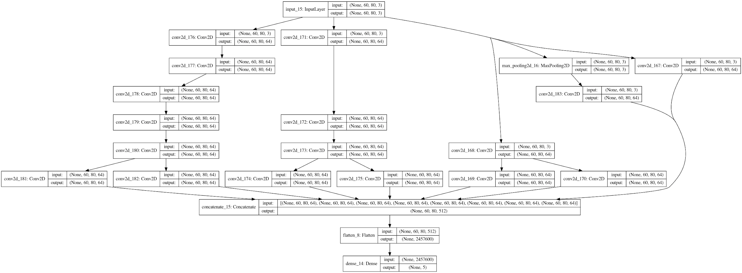
Adding factorization to the 3x3 Convolutions

Slide 18
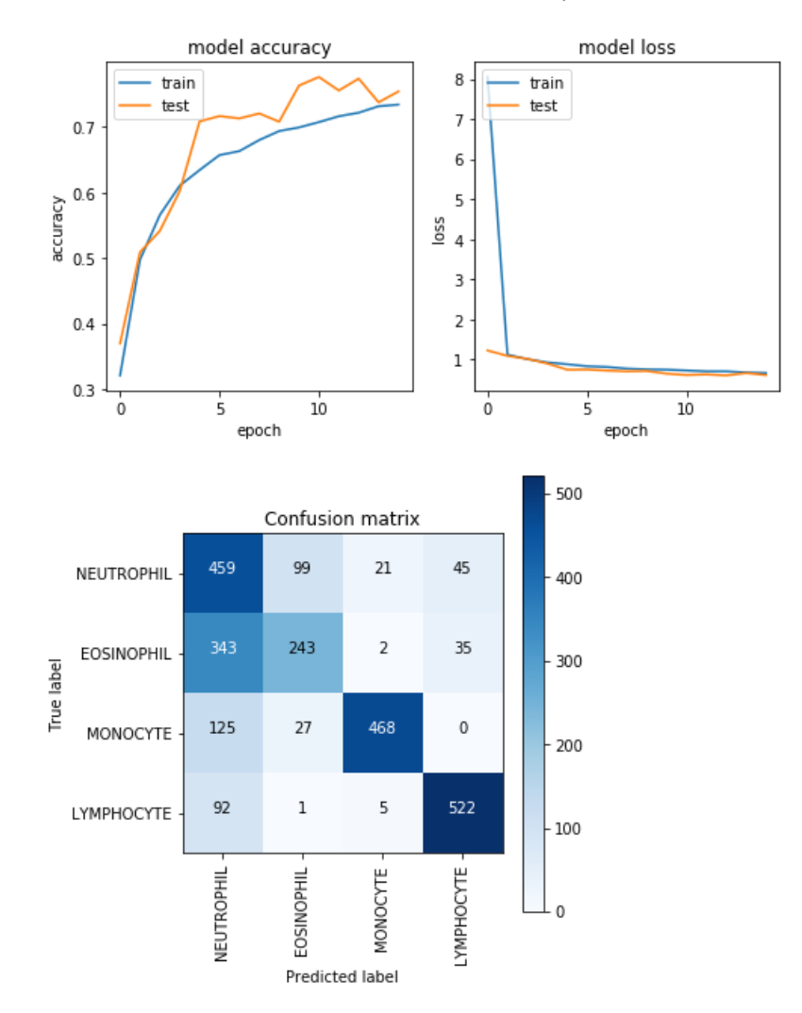
Marginal improvement
Accuracy increased to 76
Still not very impressive
More epochs might be needed

Slide 19
Sources
"Heterophil - an overview | ScienceDirect Topics". www.sciencedirect.com.
"What is an Eosinophil? | Definition & Function | CCED". www.cincinnatichildrens.org. Retrieved 14 June 2018.
"B Cell". Merriam-Webster Dictionary. Encyclopaedia Britannica. Retrieved 28 October 2011.
Nichols, BA; Bainton, DF; Farquhar, MG (1971). "Differentiation of monocytes. Origin, nature, and fate of their azurophil granules". J. Cell Biol. 50 (2): 498–515. doi:10.1083/jcb.50.2.498. PMC 2108281. PMID 4107019.
C. Szegedy et al, Rethinking the Inception Architecture for Computer Vision, https://arxiv.org/pdf/1512.00567v1.pdf
https://arxiv.org/pdf/1908.03930v1.pdf - ACNet: Strengthening the Kernel Skeletons for Powerful CNN via Asymmetric
Convolution Blocks
https://arxiv.org/pdf/1512.03385.pdf - Deep Residual Learning for Image Recognition
https://arxiv.org/pdf/1512.03965.pdf - The Power of Depth for Feedforward Neural Networks
https://arxiv.org/pdf/1610.09887.pdf - Depth-Width Tradeoffs in Approximating Natural Functions with Neural Networks

Slide 20
Thank you!
Questions?

